Slide 1
3. Region-based processing
서 재 원

Slide 2
Introduction
Determine the output pixel value using the input pixel and surrounding pixels
Widely used convolution technique
Region-based processing example
Blur
Sharpen
Edge detection
Noise cancellation

Slide 3
Convolutional Mask
Output pixel value
The sum of the input pixel and surrounding pixel values ​​multiplied by the value of the convolutional mask.
I₁ | I₂ | I₃
I₄ | I₅ | I₆
I₇ | I₈ | I₉
M₁ | M₂ | M₃
M₄ | M₅ | M₆
M₇ | M₈ | M₉
O₁ | O₂ | O₃
O₄ | O₅ | O₆
O₇ | O₈ | O₉
Input image
Convolution Mask
Out pixel
Output pixel value =
(O₅)

Slide 4
Characteristics of Convolution Masks
Use an odd number for the size of the convolution mask
Since the surrounding pixel values ​​must be considered symmetrically in each direction
Use sizes 3×3, 5×5, 7×7, etc.
The sum of the mask coefficients equals 1.
The convolutional masking result value must have the same average brightness value as the original image.
Blurring, Sharpening
Some convolution contain negative coefficients.
The sum of the coefficients is zero.
Edge detection

Slide 5
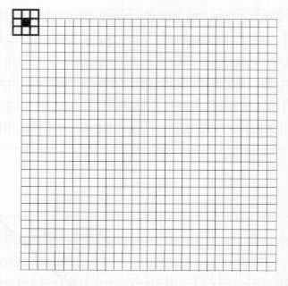
How to perform
Sliding mask
From the top left pixel to the right
When one line ends, move to the next line

Slide 6
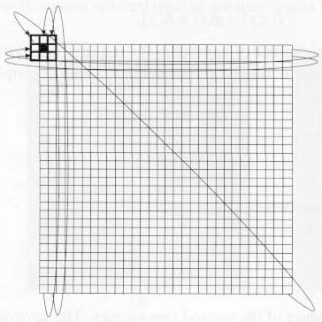
Zero padding
Pad with Zeroes
Copy of outmost pixel values
Wrap around
Copy the pixels at the border of the image
Zero padding
Copy

Slide 7
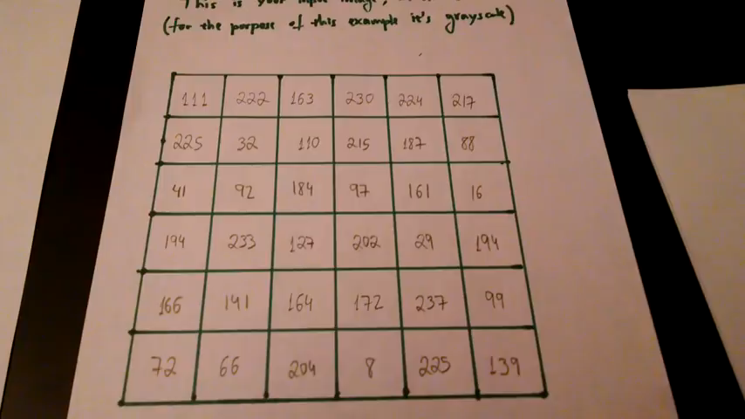
Convolution of Image
https://www.youtube.com/watch?v=YgtModJ-4cw

Slide 8
1. Blurring
A widely used convolution mask that transforms an input pixel value into an average value with surrounding pixel values ​​is:
Average Mask

Slide 9
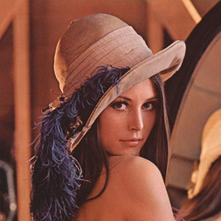


Average Masking
3 × 3 Mask
5 × 5 Mask
Input Image

Slide 10
2. Sharpening
Convolution mask for sharp image creation
The sum of all values ​​in the mask is 1
The overall brightness of the image before and after application is similar
Clipping operation required
0 | -1 | 0
-1 | 5 | -1
0 | -1 | 0
-1 | -1 | -1
-1 | 9 | -1
-1 | -1 | -1
Mask 1
Mask 2

Slide 11
Change in pixel values ​​for sharpening
0 | -1 | 0
-1 | 5 | -1
0 | -1 | 0
10 | 10 | 10 | 10 | 10 | 10 | 10 | 10 | 10
10 | 10 | 10 | 10 | 10 | 10 | 10 | 10 | 10
10 | 10 | 10 | 10 | 20 | 10 | 10 | 10 | 10
10 | 10 | 10 | 20 | 30 | 20 | 10 | 10 | 10
10 | 10 | 20 | 30 | 40 | 30 | 20 | 10 | 10
10 | 10 | 10 | 20 | 30 | 20 | 10 | 10 | 10
10 | 10 | 10 | 10 | 20 | 10 | 10 | 10 | 10
10 | 10 | 10 | 10 | 10 | 10 | 10 | 10 | 10
10 | 10 | 10 | 10 | 10 | 10 | 10 | 10 | 10
10 | 10 | 10 | 10 | 10 | 10 | 10 | 10 | 10
10 | 10 | 10 | 10 | 0 | 10 | 10 | 10 | 10
10 | 10 | 10 | 10 | 40 | 10 | 10 | 10 | 10
10 | 10 | 0 | 20 | 50 | 20 | 0 | 10 | 10
10 | 0 | 40 | 50 | 80 | 50 | 40 | 0 | 10
10 | 10 | 0 | 20 | 50 | 20 | 0 | 10 | 10
10 | 10 | 10 | 10 | 40 | 10 | 10 | 10 | 10
10 | 10 | 10 | 10 | 0 | 10 | 10 | 10 | 10
10 | 10 | 10 | 10 | 10 | 10 | 10 | 10 | 10
Input Image
Output Image

Slide 12
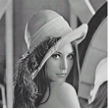
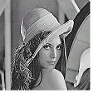
Sharpening Masking
Input Image
Result of Masking 1

Slide 13
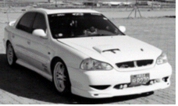
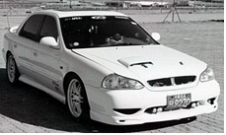
Sharpening Masking

Slide 14
3. Edge detection
Edge
Contains a lot of information about the input image
It plays a major role in identifying objects and recognizing their position, shape, size, etc.
It exists at the point where the brightness of the image changes from low value to high value or from high value to low value.

Slide 15
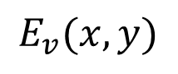
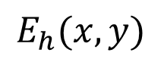
Edge detection mask
Detect sharp changes in successive pixels
Mask of horizontal and vertical edge
$$E_{h}(x,y)$$
$$E_{v}(x,y)$$
 | Horizontal mask | Vertical mask
Prewitt
Roberts
Sobel

Slide 16
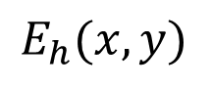
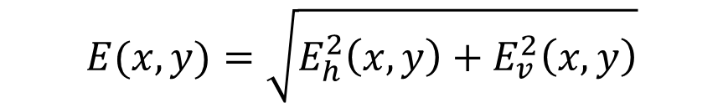
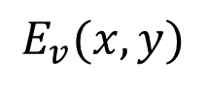
Determine Edge
The size of the probability that pixel I ( x, y ) is a borderline
$$E(x,y)=\sqrt{E_{h}^{2}\left(x,y\right)+E_{v}^{2}\left(x,y\right)}$$
$$E_{h}(x,y)$$
: Result of masking for horizontal detection
$$E_{v}(x,y)$$
: Result of masking for vertical detection

Slide 17
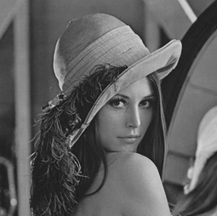
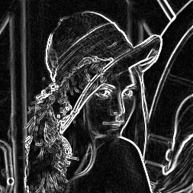
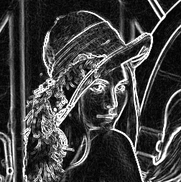
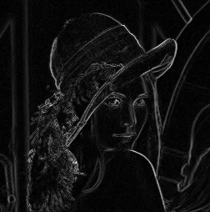
Edge detection result
Input Image
Sobel
Prewitt
Roberts

Slide 18

Edge Detection
https://www.youtube.com/watch?v=rj8WOyw280k

Slide 19
4. Noise Reduction
Noise
Gaussian noise
Noise with normal distribution
Noise that deviates irregularly from the pixel values ​​of the image but does not deviate significantly
Impulse noise
Noise caused by pixel values ​​that are distinctly different from the pixel values ​​of the image
Pixels have distinctly incorrect brightness values ​​such as 0, 255

Slide 20
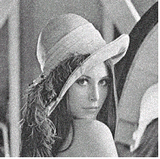
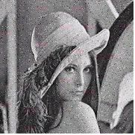
Noise example
Gaussian Noise
Impulse Noise

Slide 21
Noise reduction with Average Masking
Average mask
Effective for reducing Gaussian noise
Ineffective against impulse noise
Decreases the contrast of the image

Slide 22
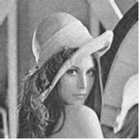
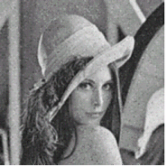
Noise reduction using average mask
Gaussian noise removal result
Impulse Noise Removal Result

Slide 23
Noise reduction with Median Filtering
Median Filtering
Effective way to eliminate impulse noise
Preserve or strengthen boundaries
Input Image
Filter Window
15
16
17
13
255
18
16
20
22
Output Image
Alignment of Pixel value
13
15
16
16
17
18
20
22
255

Slide 24
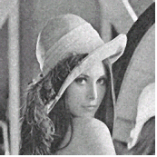
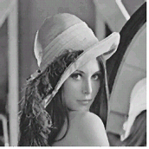
Noise reduction using median filtering
Gaussian noise removal result
Impulse Noise Removal Result

Slide 25
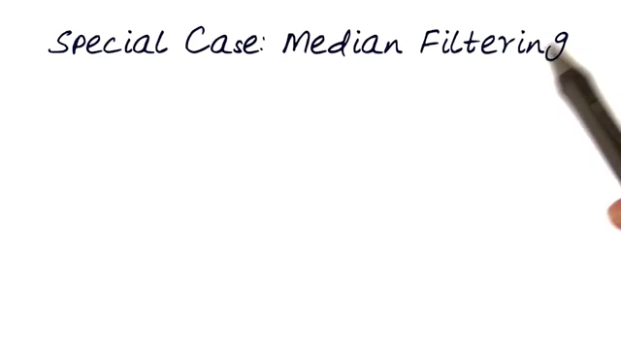
Average & Median Filtering
https://www.youtube.com/watch?v=TYNbTdzm-5w

Slide 26
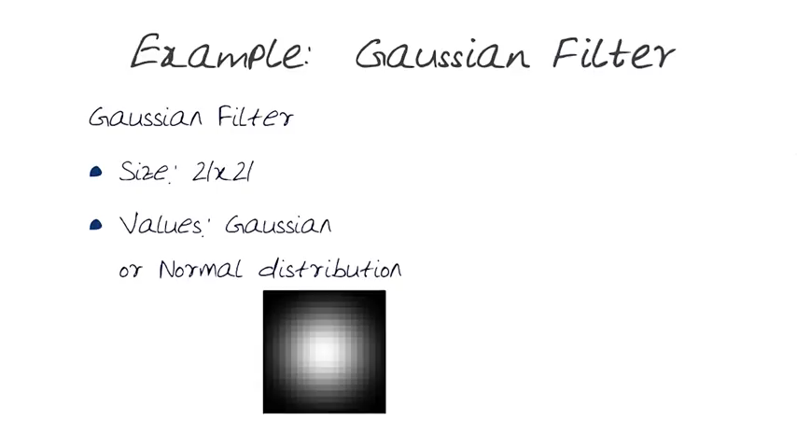
Gaussian Filter
https://www.youtube.com/watch?v=-AuwMJAqjJc

Slide 27
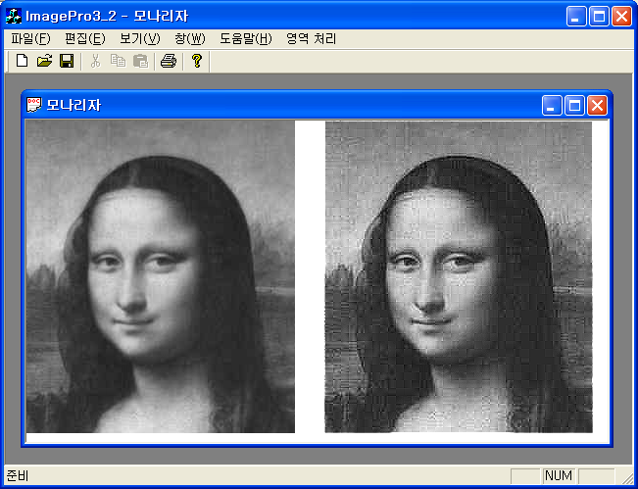
Homework 3
Sharpening

Slide 28
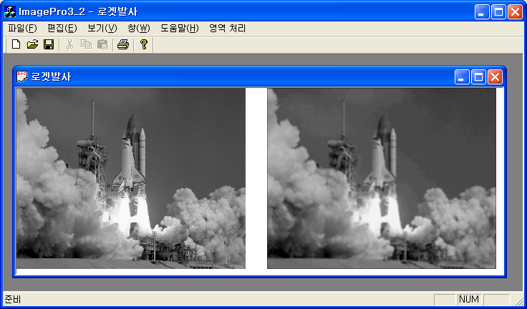
Homework 3
Averaging

Slide 29
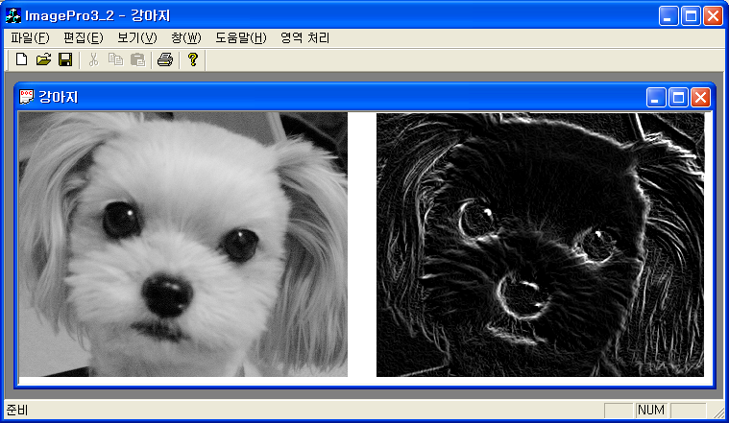
Homework 3
Edge detection

Slide 30
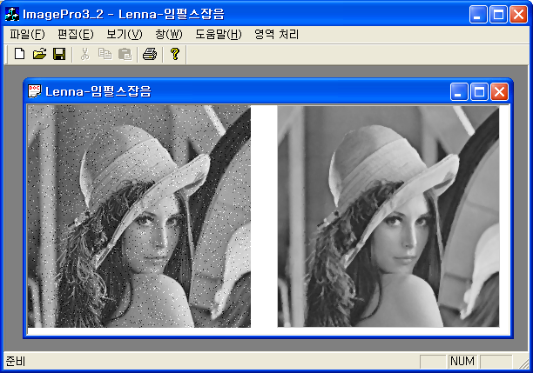
Homework 3
Median Filtering

